Slide 1
Chapter 1: Introduction to Project Management
Managing Information Technology Projects, Sixth Edition
Schwalbe
Note: See the text itself for full citations.

Slide 2
Your Expectations
Which course are you doing and how far through are you?
Have you worked in business before – if so in what types of role?
What do you hope to achieve from this course?
Why?
What are your fears / concerns

Slide 3
MY EXPECTATIONS
You actively manage your physiology
– Ask for a break if you need it
You participate and have fun
You ask and answer questions – No ideas, questions or responses are stupid ones

Slide 4
Contact Details
Lecturer : Leon Small
Telephone : 021 460 3602
Email : leons@iafrica.com
Office : Room 2.23 (15) Engineering Building

Slide 5
Course Mission
MISSION
Help you understand the basics of “successful” Project Management
in I.T
APPROACH
Ensure interactive exchange of ideas,
practices and real life experiences
Provide examples of “leading practices” in Project Management
Provide examples of “bad
practices” in Project Management
Provide hands-on practical
experience with tools and
techniques

Slide 6
Learning Objectives
Understand the growing need for better project management, especially for information technology projects
Explain what a project is, provide examples of information technology projects, list various attributes of projects, and describe the triple constraint of projects
Describe project management and discuss key elements of the project management framework, including project stakeholders, the project management knowledge areas, common tools and techniques, and project success

Slide 7
Learning Objectives (continued)
Discuss the relationship between project, program, and portfolio management and the contributions they each make to enterprise success
Understand the role of the project manager by describing what project managers do, what skills they need, and what the career field is like for information technology project managers
Describe the project management profession, including its history, the role of professional organizations like the Project Management Institute (PMI), the importance of certification and ethics, and the advancement of project management software

Slide 8
Introduction (continued)
Many organizations today have a new or renewed interest in project management
Computer hardware, software, networks, and the use of interdisciplinary and global work teams have radically changed the work environment
The world as a whole spends nearly $10 trillion of its $40.7 trillion gross product on projects of all kinds
More than 16 million people regard project management as their profession

Slide 9
Project Management Statistics
Total global spending on technology goods, services, and staff was projected to reach $2.4 trillion in 2008, an 8 percent increase from 2007
In the U.S. the size of the IT workforce topped 4 million workers for the first time in 2008
In 2007 the total compensation for the average senior project manager in U.S. dollars was $104,776 per year in the United States, $111,412 in Australia, and $120,364 in the United Kingdom
The number of people earning their Project Management Professional (PMP) certification continues to increase

Slide 10
Motivation for Studying Information Technology (IT) Project Management
IT Projects have a terrible track record, as described in the What Went Wrong?
A 1995 Standish Group study (CHAOS) found that only 16.2% of IT projects were successful in meeting scope, time, and cost goals; over 31% of IT projects were canceled before completion
A PricewaterhouseCoopers study found that overall, half of all projects fail and only 2.5% of corporations consistently meet their targets for scope, time, and cost goals for all types of project

Slide 11
Advantages of Using Formal Project Management
Better control of financial, physical, and human resources
Improved customer relations
Shorter development times
Lower costs
Higher quality and increased reliability
Higher profit margins
Improved productivity
Better internal coordination
Higher worker morale

Slide 12
What Is a Project?
A project is “a temporary endeavor undertaken to create a unique product, service, or result” (PMBOK® Guide, Fourth Edition, 2008, p. 5)
Operations is work done to sustain the business
Projects end when their objectives have been reached or the project has been terminated
Projects can be large or small and take a short or long time to complete

Slide 13
Examples of IT Projects
A technician replaces ten laptops for a small department
A small software development team adds a new feature to an internal software application for the finance department
A college campus upgrades its technology infrastructure to provide wireless Internet access across the whole campus
A cross-functional task force in a company decides what Voice-over-Internet-Protocol (VoIP) system to purchase and how it will be implemented

Slide 14
Top Strategic Technologies for 2008 (Gartner)
Green IT
Unified communications
Business process modeling
Virtualization 2.0
Social software

Slide 15
Media Snapshot: Where IT Matters
In 2006, Baseline Magazine published “Where I.T. Matters: How 10 Technologies Transformed 10 Industries” as a retort to Nicholas Carr’s ideas (author of “IT Doesn’t Matter”)
VoIP has transformed the telecommunications industry and broadband Internet access
Global Positioning Systems (GPS) has changed the farming industry
Digital supply chain has changed the entertainment industry’s distribution system

Slide 16
Project Attributes
A project:
Has a unique purpose
Is temporary
Is developed using progressive elaboration
Requires resources, often from various areas
Should have a primary customer or sponsor
The project sponsor usually provides the direction and funding for the project
Involves uncertainty

Slide 17
Project and Program Managers
Project managers work with project sponsors, the project team, and other people involved in a project to meet project goals
Program: group of related projects managed in a coordinated way to obtain benefits and control not available from managing them individually (PMBOK® Guide, Fourth Edition, 2008, p. 9)
Program managers oversee programs; often act as bosses for project managers

Slide 18
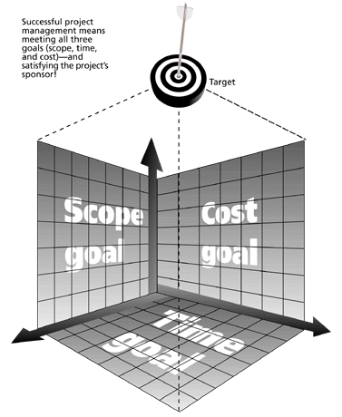
Figure 1-1 The Triple Constraint of Project Management
Successful project management means meeting all three goals (scope, time, and cost) – and satisfying the project’s sponsor!

Slide 19
What is Project Management?
Project management is “the application of knowledge, skills, tools and techniques to project activities to meet project requirements” (PMBOK® Guide, Fourth Edition, 2008, p. 6)
Project managers strive to meet the triple constraint by balancing project scope, time, and cost goals

Slide 20
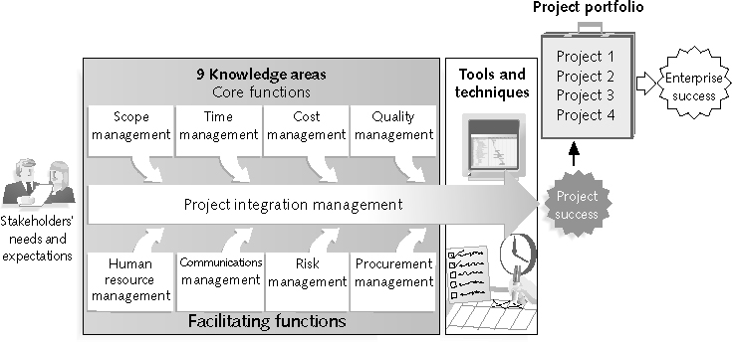
Figure 1-2 Project Management Framework

Slide 21
Project Stakeholders
Stakeholders are the people involved in or affected by project activities
Stakeholders include:
The project sponsor
The project manager
The project team
Support staff
Customers
Users
Suppliers
Opponents to the project

Slide 22
9 Project Management Knowledge Areas
Knowledge areas describe the key competencies that project managers must develop
4 core knowledge areas lead to specific project objectives (scope, time, cost, and quality)
4 facilitating knowledge areas are the means through which the project objectives are achieved (human resources, communication, risk, and procurement management
1 knowledge area (project integration management) affects and is affected by all of the other knowledge areas
All knowledge areas are important!

Slide 23
Project Management Tools and Techniques
Project management tools and techniques assist project managers and their teams in various aspects of project management
Some specific ones include:
Project charter, scope statement, and WBS (scope)
Gantt charts, network diagrams, critical path analysis, critical chain scheduling (time)
Cost estimates and earned value management (cost)
See Table 1-1 for many more

Slide 24
Super Tools
“Super tools” are those tools that have high use and high potential for improving project success, such as:
Software for task scheduling (such as project management software)
Scope statements
Requirements analyses
Lessons-learned reports
Tools already extensively used that have been found to improve project importance include:
Progress reports
Kick-off meetings
Gantt charts
Change requests

Slide 25
What Went Right? Improved Project Performance
The Standish Group’s CHAOS studies show improvements in IT projects in the past decade:
The number of successful IT projects has more than doubled, from 16 percent in 1994 to 35 percent in 2006
The number of failed projects decreased from 31 percent in 1994 to 19 percent in 2006
The United States spent more money on IT projects in 2006 than 1994 ($346 billion and $250 billion, respectively), but the amount of money wasted on challenged and failed projects was down to $53 billion in 2006 compared to $140 billion in 1994

Slide 26
Why the Improvements?
"The reasons for the increase in successful projects vary. First, the average cost of a project has been more than cut in half. Better tools have been created to monitor and control progress and better skilled project managers with better management processes are being used. The fact that there are processes is significant in itself.”*
*Standish Group, "CHAOS 2001: A Recipe for Success" (2001).

Slide 27
Project Success
There are several ways to define project success:
The project met scope, time, and cost goals
The project satisfied the customer/sponsor
The results of the project met its main objective, such as making or saving a certain amount of money, providing a good return on investment, or simply making the sponsors happy

Slide 28
Table 1-2: What Helps Projects Succeed?*
1. Executive support
2. User involvement
3. Experienced project
manager
4. Clear business objectives
5. Minimized scope
6. Standard software
infrastructure
7. Firm basic requirements
8. Formal methodology
9. Reliable estimates
10. Other criteria, such as
small milestones, proper
planning, competent
staff, and ownership
*The Standish Group, “Extreme CHAOS,” (2001).

Slide 29
What the Winners Do…
Recent research findings show that companies that excel in project delivery capability:
Use an integrated project management toolbox (use standard/advanced PM tools, lots of templates)
Grow project leaders, emphasizing business and soft skills
Develop a streamlined project delivery process
Measure project health using metrics, like customer satisfaction or return on investment

Slide 30
Program and Project Portfolio Management
A program is “a group of related projects managed in a coordinated way to obtain benefits and control not available from managing them individually” (PMBOK® Guide, Fourth Edition, 2008, p. 9)
A program manager provides leadership and direction for the project managers heading the projects within the program
Examples of common programs in the IT field include infrastructure, applications development, and user support

Slide 31
Project Portfolio Management
As part of project portfolio management, organizations group and manage projects and programs as a portfolio of investments that contribute to the entire enterprise’s success
Portfolio managers help their organizations make wise investment decisions by helping to select and analyze projects from a strategic perspective

Slide 32
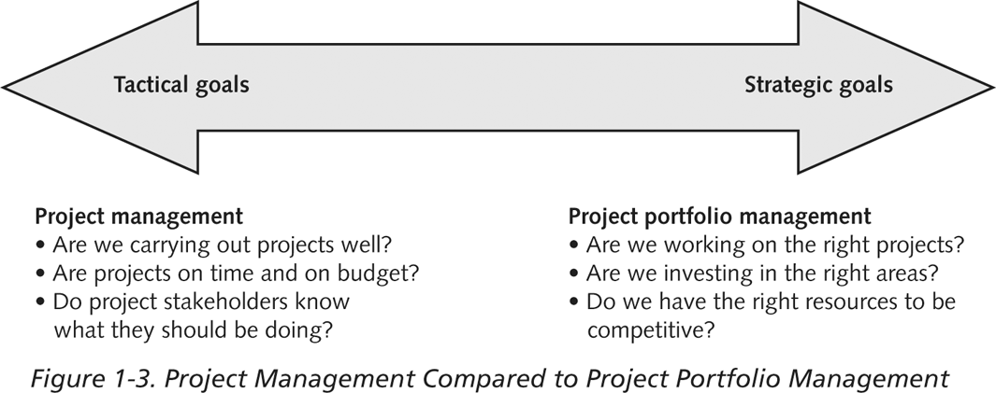
Figure 1-3. Project Management Compared to Project Portfolio Management

Slide 33
Best Practice
A best practice is “an optimal way recognized by industry to achieve a stated goal or objective”*
Robert Butrick suggests that organizations need to follow basic principles of project management, including these two mentioned earlier in this chapter:
Make sure your projects are driven by your strategy; be able to demonstrate how each project you undertake fits your business strategy, and screen out unwanted projects as soon as possible
Engage your stakeholders; ignoring stakeholders often leads to project failure; be sure to engage stakeholders at all stages of a project, and encourage teamwork and commitment at all times
*Project Management Institute, Organizational Project Management Maturity Model
(OPM3) Knowledge Foundation (2003), p. 13.

Slide 34
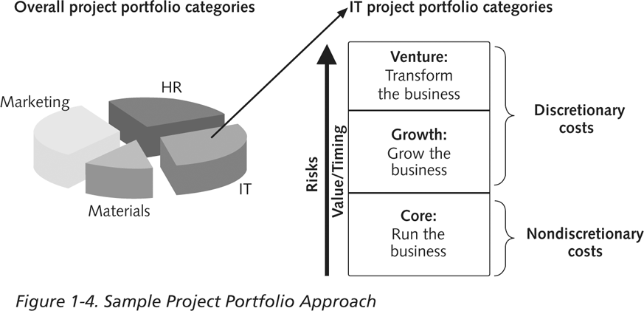
Figure 1-4. Sample Project Portfolio Approach

Slide 35
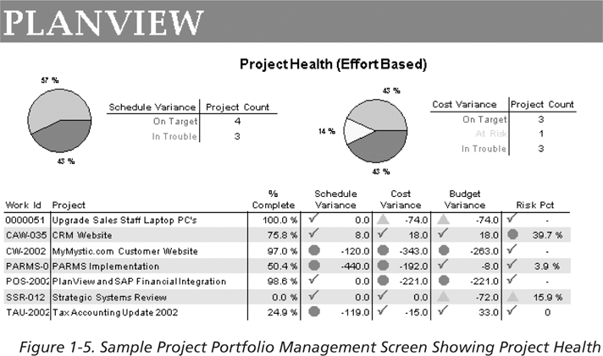
Figure 1-5. Sample Project Portfolio Management Screen Showing Project Health

Slide 36
Suggested Skills for Project Managers
Project managers need a wide variety of skills
They should:
Be comfortable with change
Understand the organizations they work in and with
Be able to lead teams to accomplish project goals

Slide 37
The Role of the Project Manager
Job descriptions vary, but most include responsibilities like planning, scheduling, coordinating, and working with people to achieve project goals
Remember that 97% of successful projects were led by experienced project managers, who can often help influence success factors

Slide 38
Suggested Skills for Project Managers
The Project Management Body of Knowledge
Application area knowledge, standards, and regulations
Project environment knowledge
General management knowledge and skills
Soft skills or human relations skills

Slide 39
Table 1-3. Ten Most Important Skills and Competencies for Project Managers
1. People skills
2. Leadership
3. Listening
4. Integrity, ethical behavior, consistent
5. Strong at building trust
6. Verbal communication
7. Strong at building teams
8. Conflict resolution, conflict management
9. Critical thinking, problem solving
10. Understands, balances priorities

Slide 40
Different Skills Needed in Different Situations
Large projects: leadership, relevant prior experience, planning, people skills, verbal communication, and team-building skills were most important
High uncertainty projects: risk management, expectation management, leadership, people skills, and planning skills were most important
Very novel projects: leadership, people skills, having vision and goals, self confidence, expectations management, and listening skills were most important

Slide 41
Importance of Leadership Skills
Effective project managers provide leadership by example
A leader focuses on long-term goals and big-picture objectives while inspiring people to reach those goals
A manager deals with the day-to-day details of meeting specific goals
Project managers often take on the role of both leader and manager

Slide 42
Careers for IT Project Managers
In a 2006 survey by CIO.com, IT executives ranked the skills that would be the most in demand in the next two to five years
Project/program management topped the list!

Slide 43
Table 1-4. Top IT Skills (partial list)
SKILL PERCENTAGE OF RESPONDENTS
Project/program management 60%
Business process management 55%
Business analysis 53%
Application development 52%
Database management 49%
Security 42%
Enterprise architect 41%
Strategist/internal consultant 40%

Slide 44
The Project Management Profession
The profession of project management is growing at a very rapid pace
It is helpful to understand the history of the field, the role of professional societies like the Project Management Institute, and the growth in project management software

Slide 45
History of Project Management
Some people argue that building the Egyptian pyramids was a project, as was building the Great Wall of China
Most people consider the Manhattan Project to be the first project to use “modern” project management
This three-year, $2 billion (in 1946 dollars) project had a separate project manager and a technical manager

Slide 46
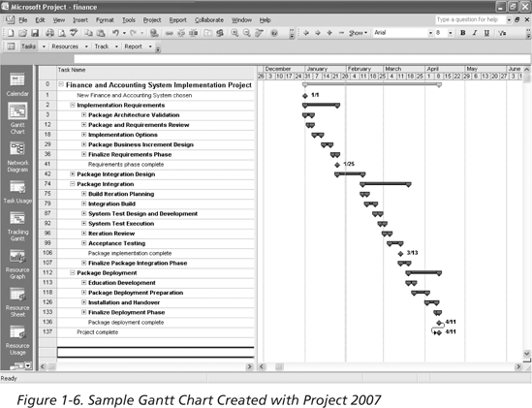
Figure 1-6. Sample Gantt Chart Created with Project 2007

Slide 47
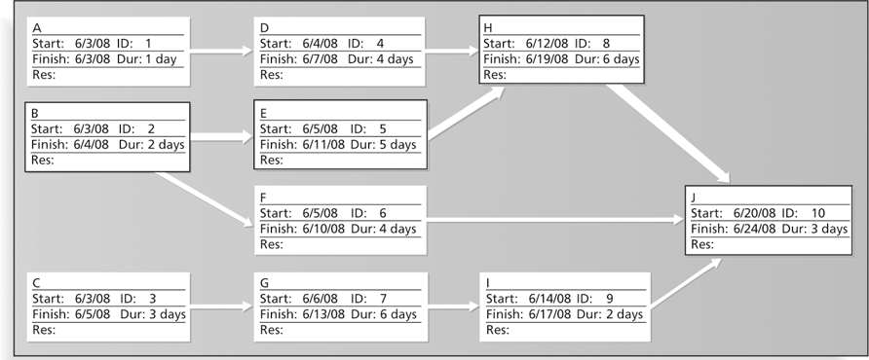
Figure 1-7. Sample Network Diagram in Microsoft Project

Slide 48
The Project Management Institute
The Project Management Institute (PMI) is an international professional society for project managers founded in 1969
PMI has continued to attract and retain members, reporting 277,221 members worldwide by August 31, 2008
There are specific interest groups in many areas, like engineering, financial services, health care, IT, etc.
Project management research and certification programs continue to grow
Students can join PMI at a reduced fee (see www.pmi.org for details)

Slide 49
Project Management Certification
PMI provides certification as a Project Management Professional (PMP)
A PMP has documented sufficient project experience, agreed to follow a code of ethics, and passed the PMP exam
The number of people earning PMP certification is increasing quickly
PMI and other organizations offer additional certification programs (see Appendix B)

Slide 50
Figure 1-8. Growth in PMP Certification, 1993-2008

Slide 51
Ethics in Project Management
Ethics, loosely defined, is a set of principles that guide our decision making based on personal values of what is “right” and “wrong”
Project managers often face ethical dilemmas
In order to earn PMP certification, applicants must agree to PMI’s Code of Ethics and Professional Conduct
Several questions on the PMP exam are related to professional responsibility, including ethics

Slide 52
Project Management Software
There are hundreds of different products to assist in performing project management
Three main categories of tools:
Low-end tools: handle single or smaller projects well, cost under $200 per user
Midrange tools: handle multiple projects and users, cost $200-600 per user, Project 2007 most popular
High-end tools: also called enterprise project management software, often licensed on a per-user basis, like VPMi Enterprise Online (www.vcsonline.com) – see front cover for trial version information
See the Project Management Center Web site or Top Ten Reviews for links to many companies that provide project management software

Slide 53
Chapter Summary
A project is a temporary endeavor undertaken to create a unique product, service, or result
Project management is the application of knowledge, skills, tools, and techniques to project activities to meet project requirements
A program is a group of related projects managed in a coordinated way
Project portfolio management involves organizing and managing projects and programs as a portfolio of investments
Project managers play a key role in helping projects and organizations succeed
The project management profession continues to grow and mature

